Slide 1
Lecture 8
Sampling and Experimental Design

Slide 2
Start with a question
How many hours a week does a typical University of Idaho student spend exercising?
We cannot ask every student. So how would you get the data?
Talk to your neighbor for one minute: who would you ask, and how would you choose them?

Slide 3
Words we need
population
the entire group we want to learn about
every University of Idaho student
parameter
a number that describes the population
the mean weekly exercise hours of ALL UI students
sample
the part of the population we actually observe
the students we end up asking
statistic
a number computed from the sample
the mean exercise hours of the students we asked

Slide 4
More words we need
census
data collected on every member of the population
asking all UI students - slow, expensive, often impossible
sampling frame
the list we actually choose the sample from
the registrar's list of enrolled students
sampling design
the rule we use to choose the sample from the frame
representative sample
a sample with the same characteristics as the population
sampling error
the gap between a statistic and the parameter, just from which units happened to be chosen
a different sample would give a slightly different answer

Slide 5
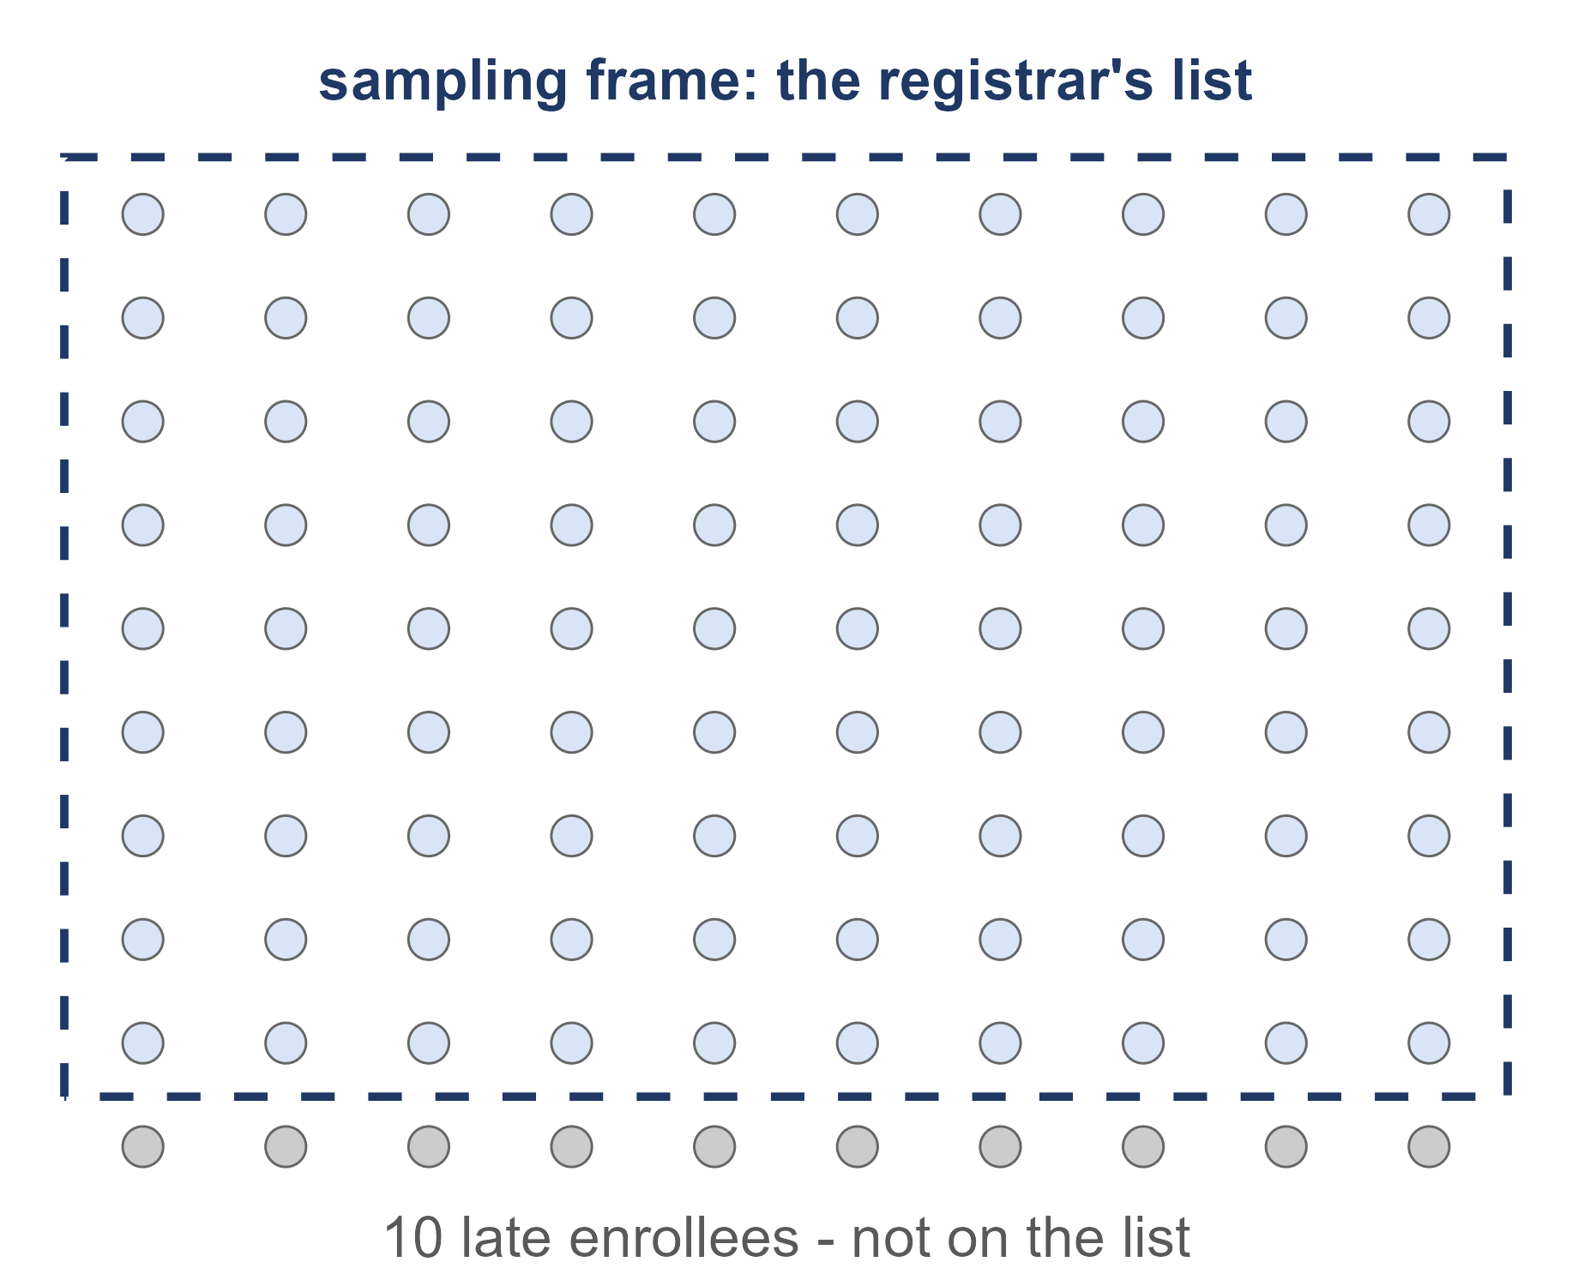
Example: exercise at a small college
A small college has 100 students. Its health center wants to know the mean number of hours students exercised last week.
1. What is the population, and what is the parameter?
All 100 students, and the mean exercise hours of all 100.
2. The registrar's list, in the dashed box, has only 90 names. What is that list?
The sampling frame. The 10 late enrollees are not on it, so they cannot be chosen.
3. What would asking all 100 students be called?
A census.

Slide 6
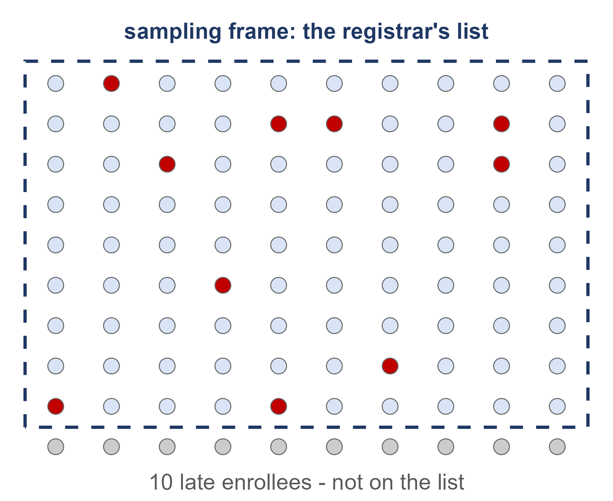
Census, sample and sampling error
census
asking all 100 students gives a mean of 4.6 hours - the parameter
sample
an SRS of 10 from the list, in red, gives a mean of 4.4 hours - the statistic
sampling error
4.4 - 4.6 = -0.2 hours. A different random sample would give a different error

Slide 7
Practice: find the sampling frame
1. Student government wants to know how students feel about a parking-fee increase. It emails a survey to 500 students picked at random from the university email directory.
Frame: the university email directory. It lists nearly every enrolled student, so it matches the population well.
2. A Moscow coffee shop wants its customers' opinions on a new menu. It surveys 100 people picked at random from its loyalty-app members.
Frame: the loyalty-app member list. Customers who never joined the app cannot be chosen.
3. A city council wants residents' views on a new bike lane. It calls numbers picked at random from a printed phone directory.
Frame: the phone directory. It misses everyone without a listed landline - a group that skews young.

Slide 8
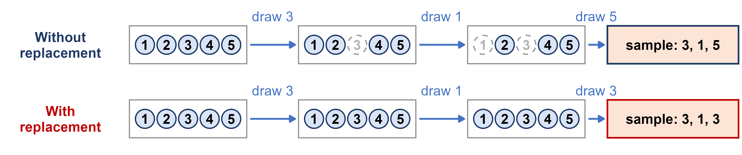
With or without replacement?
sampling without replacement
a picked unit is set aside, so it can be chosen only once
sampling with replacement
a picked unit is put back, so it could be chosen again
Surveys sample without replacement. When the population is much bigger than the sample, the two give practically the same results.

Slide 9
Be Skeptical
Problems with samples
Self-selected samples
Sample size
Is the sample representative? A biased sample gives results that are not valid.
Only people who chose to respond, as in call-in or online polls - often unreliable.
Samples that are too small may be unreliable. Larger is better when possible.
Undue influence
Nonresponse
Causality
Were the questions asked in a way that pushes people toward an answer?
Did many people refuse? Those who do answer may have strong opinions.
A relationship between two variables does not mean one causes the other.
Self-funded studies
Misleading use of data
Confounding
Who paid for it, and why? Read it critically - but judge it on its merits.
Watch for badly displayed graphs, incomplete data, or missing context.
The effects of several factors on the response cannot be separated.
Source: Introductory Statistics 2e (OpenStax), Section 1.2, Critical Evaluation

Slide 10
Two easy ways to get a sample
convenience sample
ask whoever is easiest to reach
stand outside the Student Recreation Center and ask the first 50 people who walk by
voluntary response sample
put out a call and let people choose whether to answer (the textbook calls these self-selected samples)
post a poll on a UI student Instagram account and count the replies
Both are quick, cheap and easy. So what is the problem?

Slide 11
What could go wrong?
For each story: is it a convenience sample or a voluntary response sample? What could go wrong?
1. A nutrition club wants to know how many servings of vegetables UI students eat a day. Members ask the first 60 students who walk out of the campus dining hall at lunch.
Convenience sample. Only lunchtime dining-hall eaters can be chosen - off-campus students and students who cook for themselves are missed.
2. The campus paper wants to know whether students favor moving 8 a.m. classes later. It posts a Vote now! link on social media: 1,200 students vote and 85% say yes.
Voluntary response sample. Students who dread 8 a.m. classes are the most eager to vote, so 85% likely overstates support.
3. A professor wants to know how many hours a week the 300 students in her lecture study. She asks the 25 students who come to her office hours that week.
Convenience sample - just whoever was there. Students who come to office hours probably study more than the class as a whole.

Slide 12
17.5 million votes
On December 18, 2022, Elon Musk posted a poll: “Should I step down as head of Twitter? I will abide by the results of this poll.” In 12 hours it drew more than 17.5 million votes, and 57.5% said yes.
1. Who could vote in this poll?
Anyone who saw the post and chose to vote - mostly Musk's own followers. Nothing stopped fake accounts from voting.
2. What kind of sample is this?
A voluntary response sample.
3. So does 57.5% tell us what Twitter users - or anyone else - think?
No. 17.5 million self-selected votes describe only the people who chose to vote. Size does not fix that.
Sources: NBC News; Associated Press (December 19, 2022)

Slide 13
Online opt-in polls
Many online polls use opt-in panels: anyone can sign up to take surveys, and they are paid for each one they finish.
1. In opt-in polls, what percent of adults under 30 said they were licensed to operate a nuclear submarine?
12% - and 24% of Hispanic respondents. Almost nobody is licensed to operate a nuclear submarine.
2. An opt-in poll found 20% of adults under 30 agreed that the Holocaust is a myth. Pew asked the same question of a random sample. What did it find?
3%. Bogus and careless respondents answering for the money made most of the 20%.
3. Why does this matter for how we read headlines about young people?
Opt-in panels are voluntary response samples. A shocking number about a subgroup may be about who signed up, not what people think.
Source: Mercer, Kennedy and Keeter (2024), Pew Research Center

Slide 14
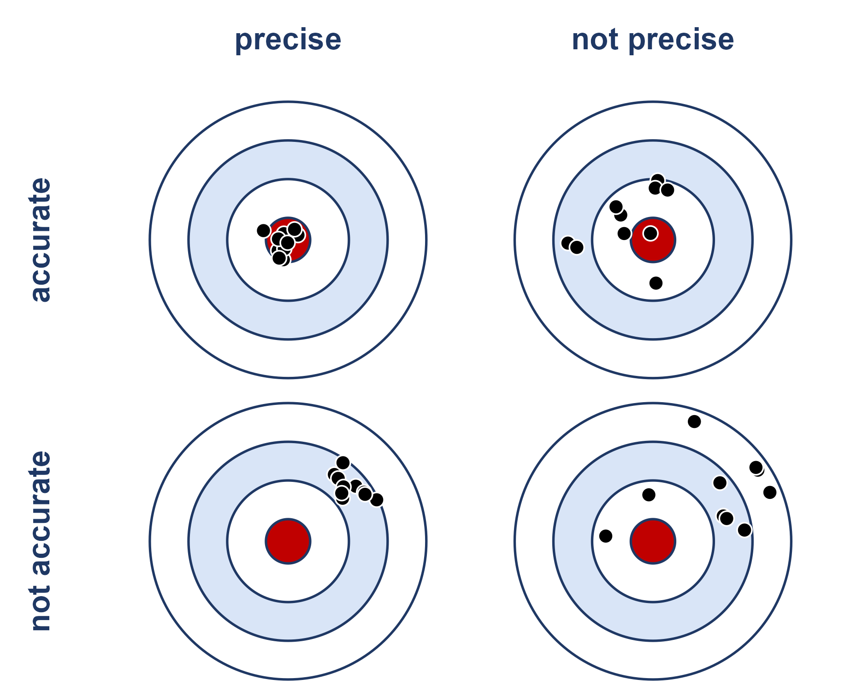
Estimates are shots at a target
The bullseye is the parameter. Each shot is the estimate from one sample - take a new sample, take a new shot.
bias
the shots are centered off the bullseye, missing in the same direction every time: an ACCURACY problem
standard error
how spread out the shots are from one sample to the next: a PRECISION problem
Convenience and voluntary response samples are biased: they miss the bullseye however carefully we aim.

Slide 15
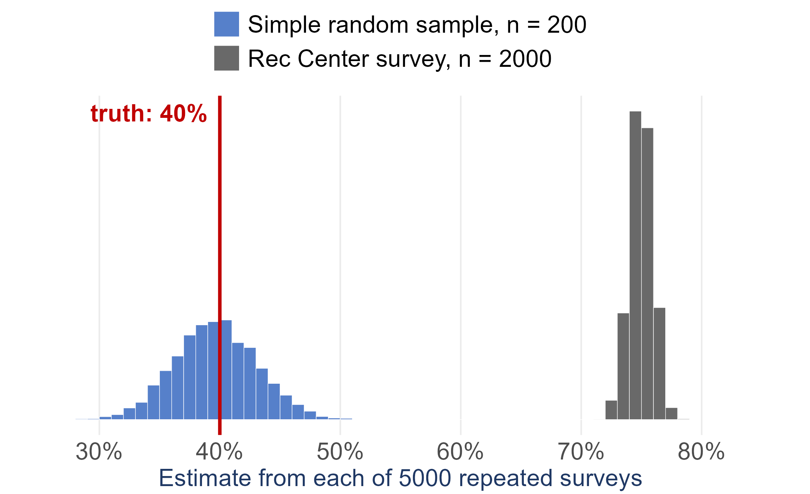
A bigger sample does not fix bias
Suppose 40% of UI students exercise at least three times a week
Blue: 5000 simple random samples of 200 students
Grey: 5000 Rec Center surveys of 2000 students
The Rec Center survey is more precise - a smaller standard error
and every one of its estimates misses the truth: bias
More data buys precision. Only a better design buys accuracy

Slide 16
The fix: let chance choose
Convenience and voluntary response samples go wrong because a person decides who gets in. Take the person out of it.
random sampling
using chance to choose the sample, so neither the researcher nor the respondents decide who is in it
No person is doing the choosing, so the selection cannot systematically favor anyone - no bias from the selection itself
Chance still moves the estimate from sample to sample, but by rules we understand - so we can measure it. That is the standard error

Slide 17
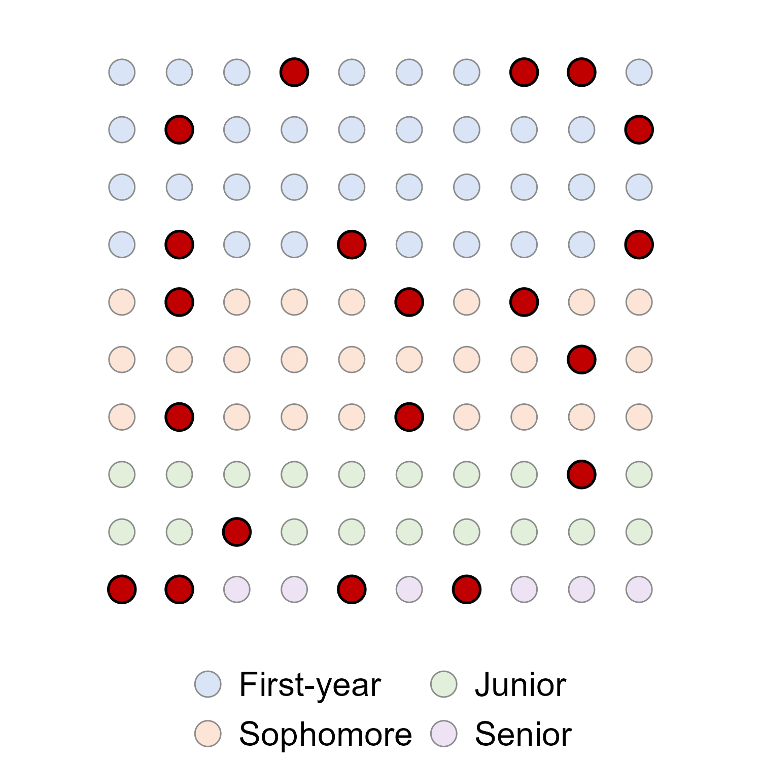
Simple random sample (SRS)
simple random sample (SRS)
every possible group of n units has the same chance of being the sample
Here N = 100 students and n = 20, so each student has a 20/100 = 1 in 5 chance of being chosen
This SRS happened to draw 4 seniors but only 2 juniors. An SRS is fair on average - not balanced every time

Slide 18
Drawing an SRS in practice
1. Get a sampling frame and number it 1 to N
2. Let a random number generator choose n different numbers
in R: sample(1:379, 30) picks 30 of 379 row numbers
3. The units with those numbers are the sample
sample() draws without replacement - no row can be picked twice - unless you add replace = TRUE
This is exactly what Part 3 of your course project asks you to do.

Slide 19
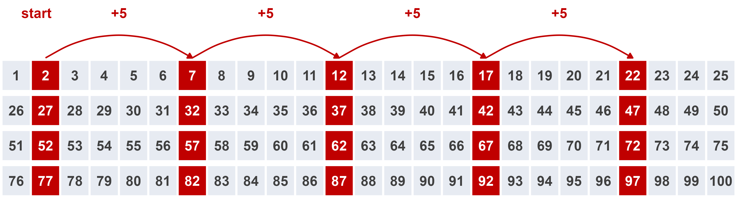
Systematic sample
systematic sample
pick a random starting point among the first k units of an ordered list, then take every kth unit after it
k = N/n = 100/20 = 5. Random start = 2, so we take list positions 2, 7, 12, 17, ... , 97
Works like an SRS - unless the list has a repeating pattern that lines up with k

Slide 20
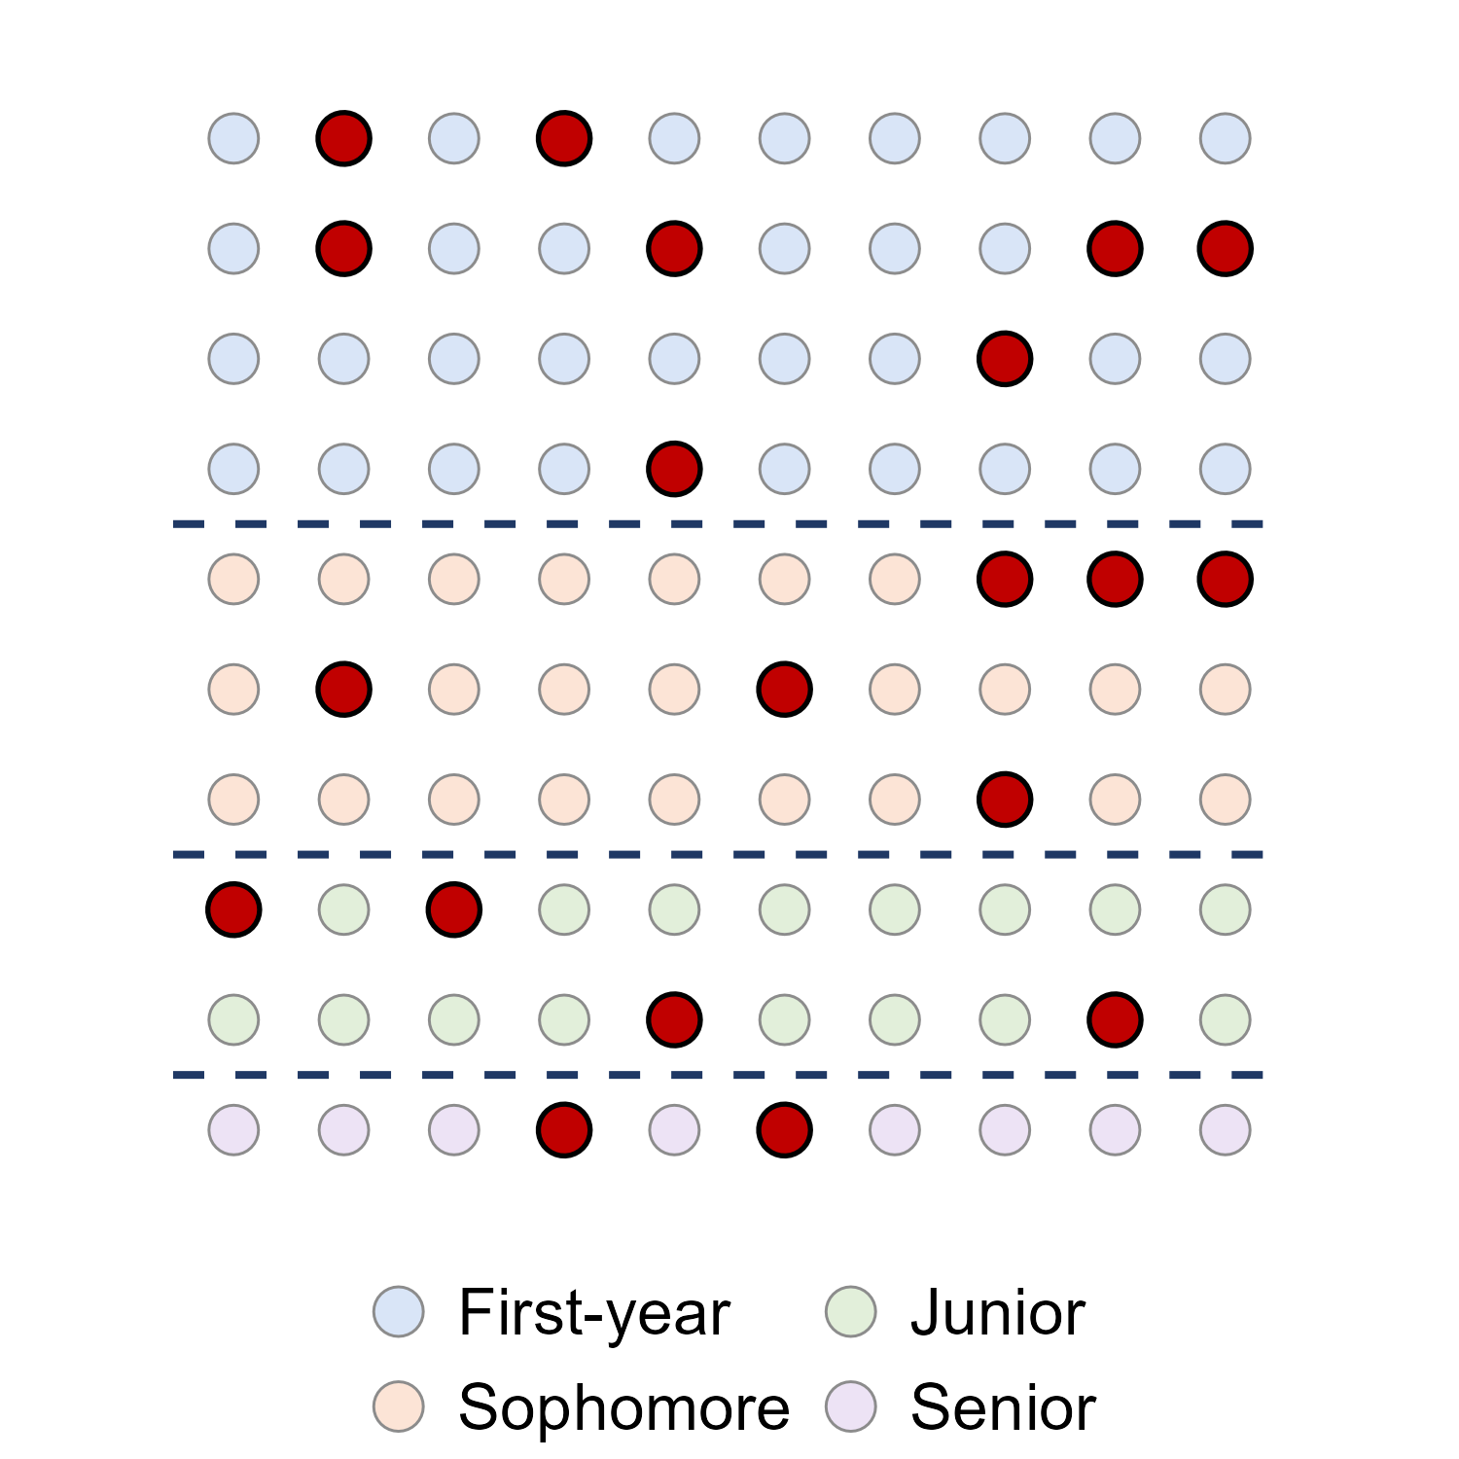
Stratified random sample
strata
groups of units that are alike, formed BEFORE sampling - class year, region, age group
stratified random sample
a separate SRS inside every stratum, combined into one sample
proportional allocation
each stratum gets its share of n: 40, 30, 20, 10 students -> 8, 6, 4, 2
Every group is guaranteed a place - no more 2 juniors by bad luck

Slide 21
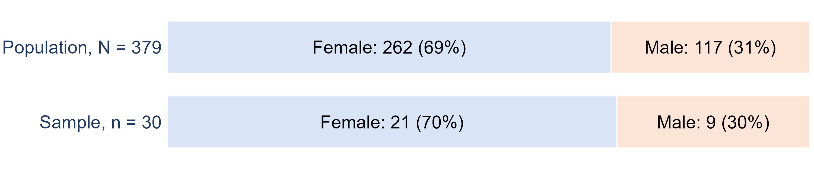
Proportional allocation with real data
heights.csv (on the course Data page) has N = 379 people: 262 female and 117 male. Stratify by sex for a sample of n = 30:
female: 30 x 262/379 = 20.74, so 21
male: 30 x 117/379 = 9.26, so 9
Then an SRS of 21 of the women, and a separate SRS of 9 of the men

Slide 22
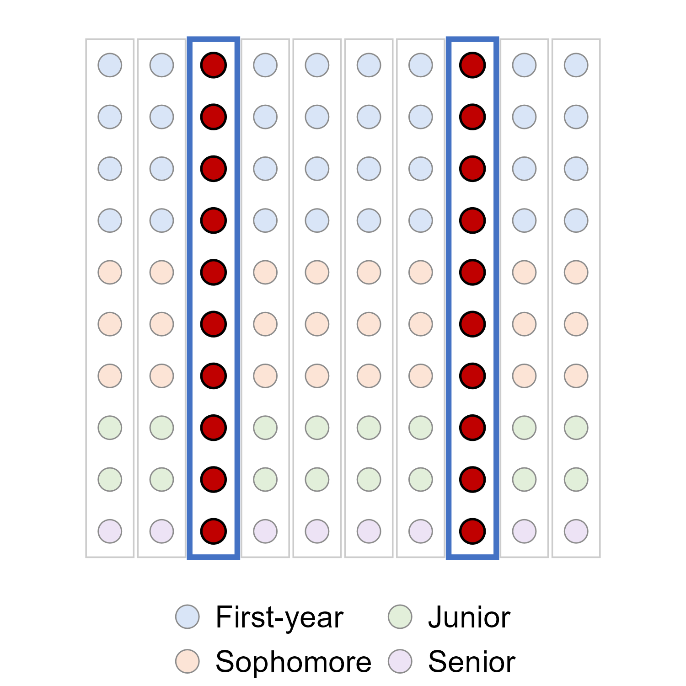
Cluster sample
cluster
a group of units that occurs naturally - a dorm, a classroom, a city block
cluster sample
an SRS of clusters, then measure EVERY unit in the clusters chosen
Only needs a list of clusters, not of every person - and far less travel
Works best when each cluster is a mini-population: mixed inside, like each column here

Slide 23
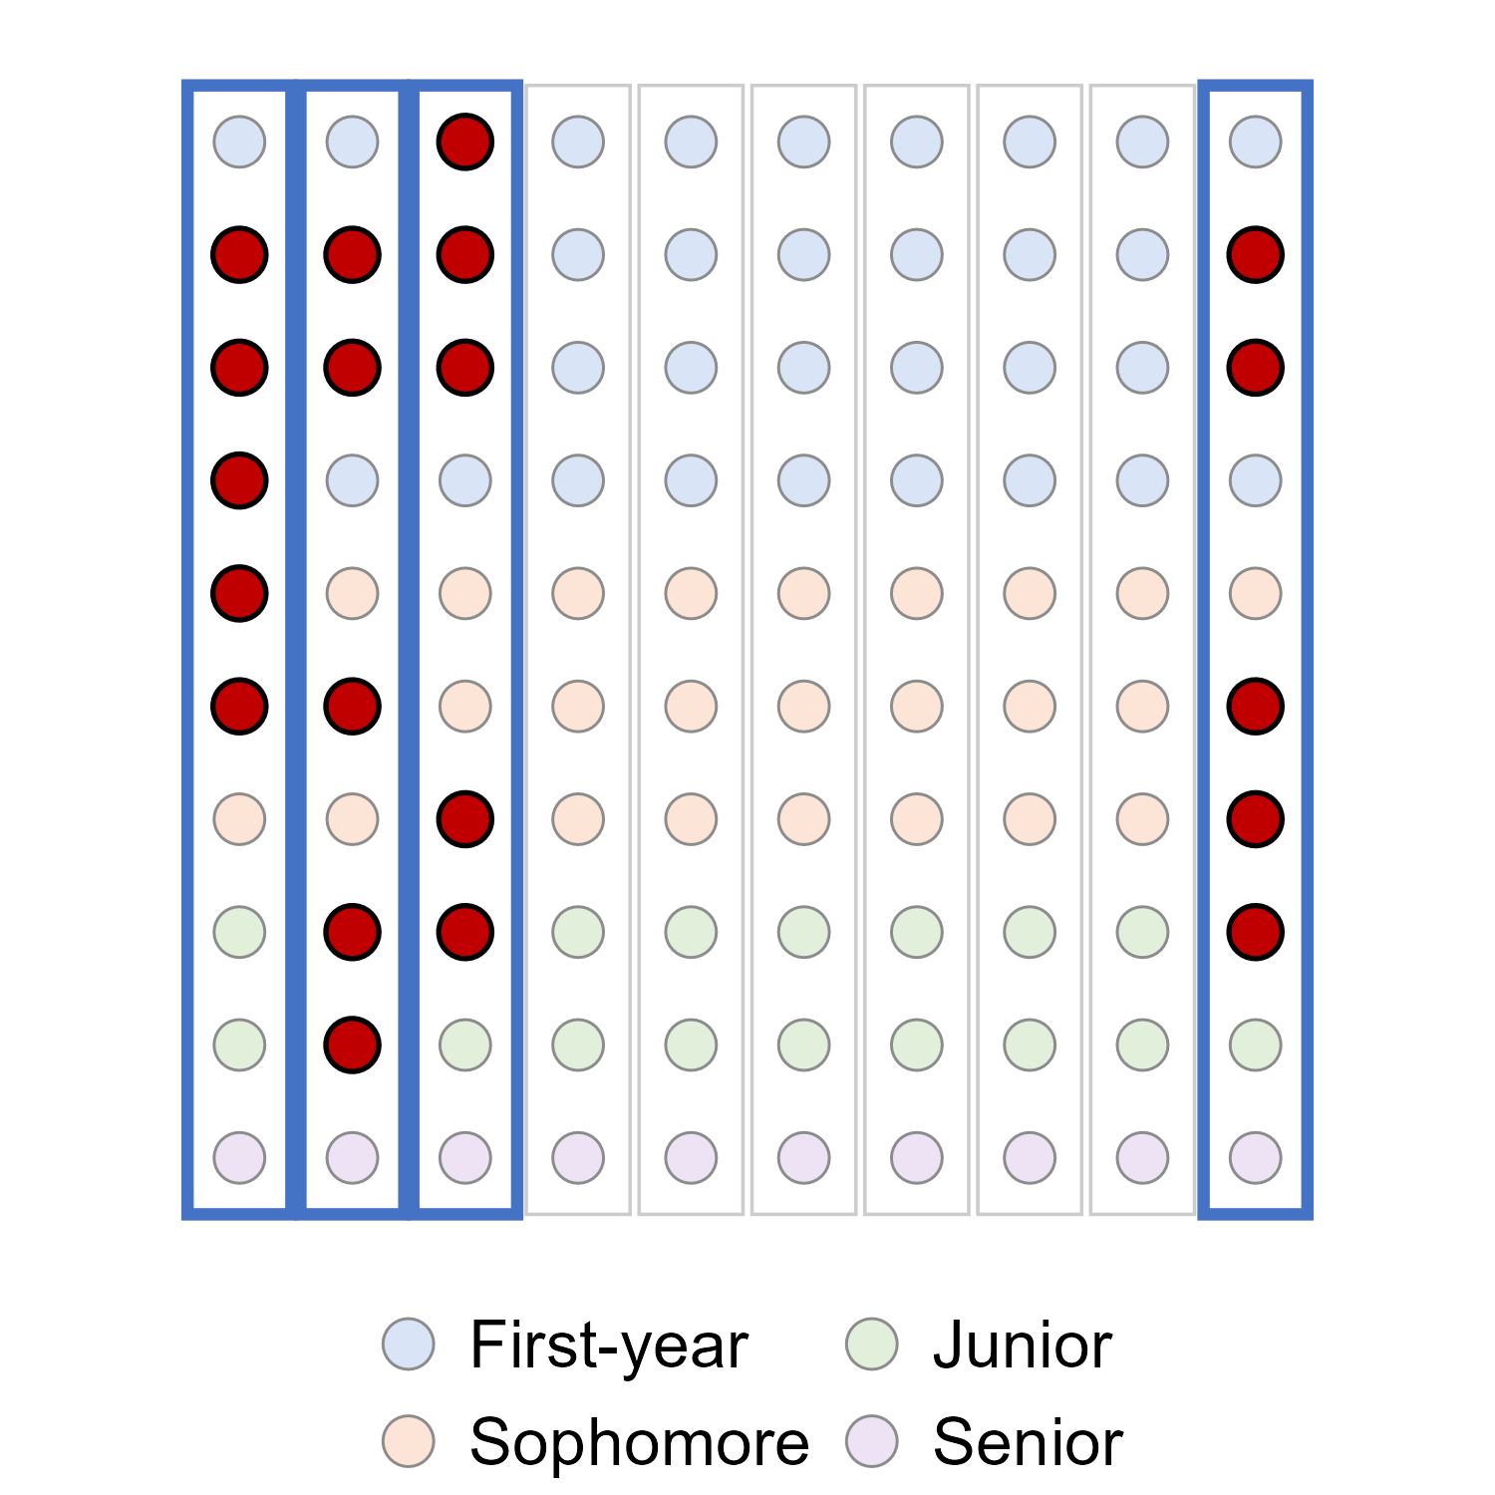
Two-stage cluster sample
two-stage cluster sample
stage 1: an SRS of clusters. Stage 2: an SRS of units inside each chosen cluster
Here: 4 of the 10 columns, then 5 students in each, n = 20
Exit polls work this way: sample polling places, then interview every nth voter leaving each one
National surveys such as NHANES stack it all: strata, clusters inside strata, households inside clusters

Slide 24
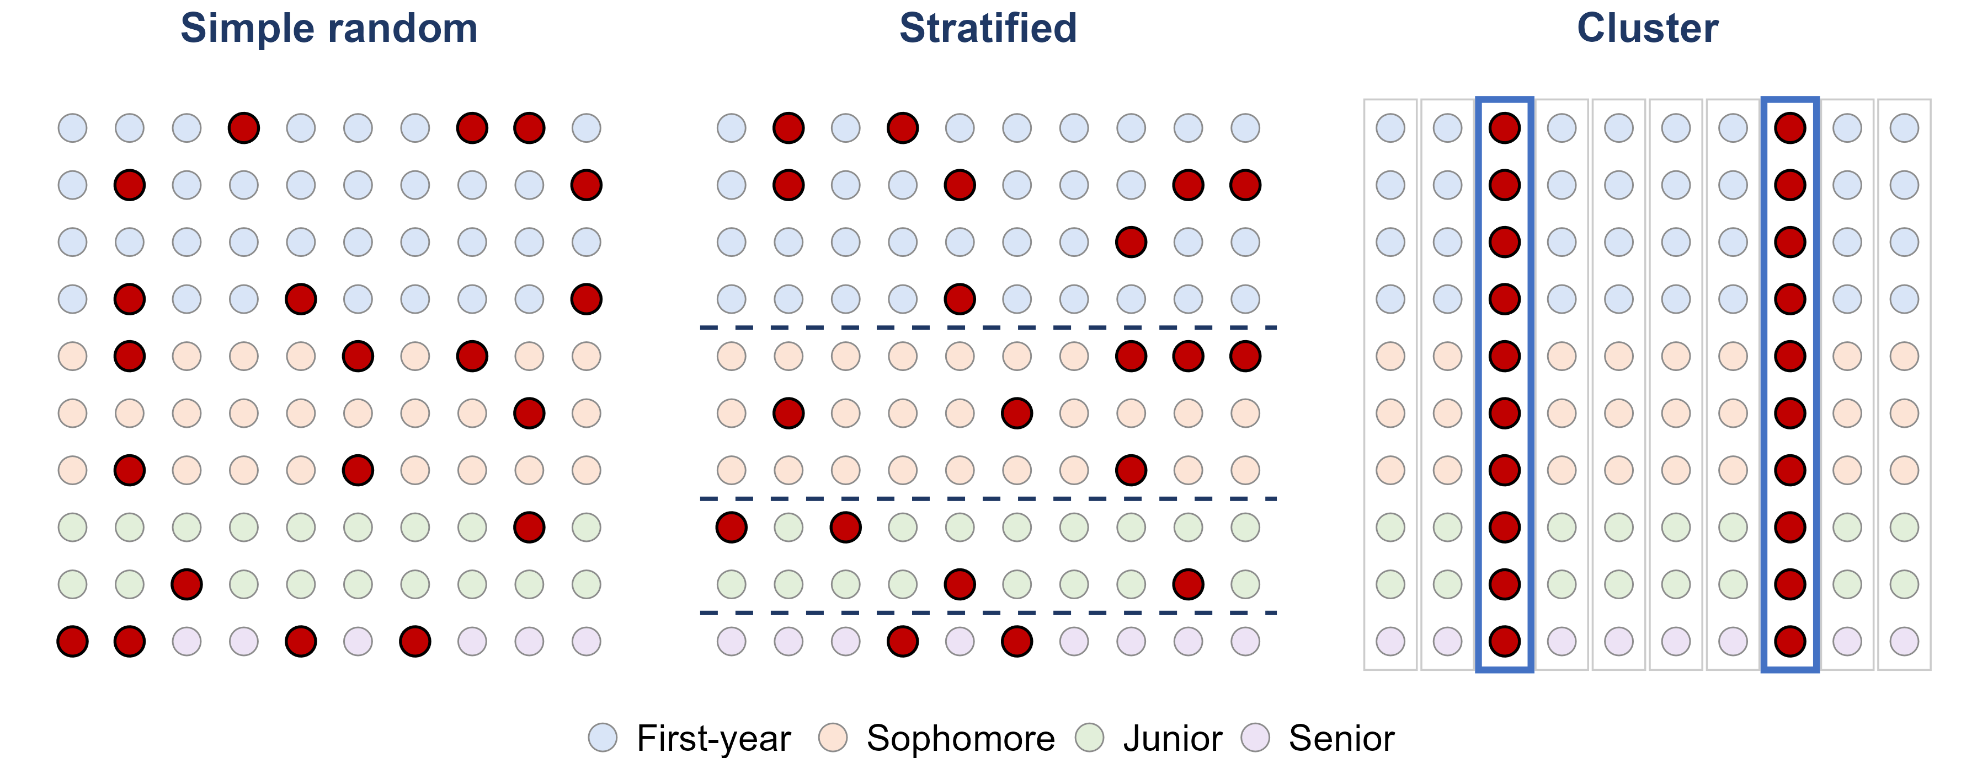
Strata vs. clusters
Strata: alike inside - sample from EVERY one. Clusters: mixed inside - sample SOME, whole.

Slide 25
Two kinds of error
sampling error
the natural gap between a sample and the population, caused by which units happened to be chosen
every sample has some - a larger sample makes it smaller
nonsampling error
errors that do not come from chance - biased methods, bad questions, data-entry mistakes, faulty instruments
a larger sample does not make these smaller
sampling bias
some members of the population are less likely to be chosen than others
convenience and voluntary response samples, or a frame that leaves people out

Slide 26
Three common nonsampling errors
Even a perfectly random design can end up biased:
undercoverage
the sampling frame leaves part of the population out
students who are not on the list you sampled from
nonresponse
people who are chosen cannot be reached, or refuse to answer
a problem when the people who do not answer differ from those who do
response bias
the answers themselves are wrong
leading or confusing questions, sensitive topics, wanting to please the interviewer

Slide 27
Nonresponse: when nobody picks up
Pew Research Center reached 36% of the people it called for its phone surveys in 1997. By 2018 it reached 6%.
1. Does a 6% response rate automatically make a survey biased?
No - only if the people who answer differ from the people who do not. The trouble is that you usually cannot check.
2. In 2020, national polls in the final two weeks overstated Biden's margin by 3.9 points on average - the largest error in 40 years. What could cause that?
The pollsters' own task force concluded that at least some of the error came from nonresponse: the people who answered differed from those who did not.
Sources: Pew Research Center (2019); AAPOR Task Force on 2020 Pre-Election Polling (2021)

Slide 28
Question wording: same law, two names
In September 2013, CNBC asked half of its poll respondents about “Obamacare” and the other half about “the Affordable Care Act” - the same law.
1. Which name do you think drew more opposition?
Obamacare: 46% opposed it, against 37% for the Affordable Care Act.
2. So did fewer people support Obamacare, too?
No - 29% supported Obamacare and 22% the ACA. 30% said they did not know about the ACA, but only 12% about Obamacare.
3. What does this tell you about survey questions?
The words in a question change the answers. A familiar, politically loaded name pulled people off the fence.
Sources: NBC News (September 27, 2013); Harvard Political Review

Slide 29
Practice: name the sampling design
1. A reporter interviews the first 50 students who walk out of the Idaho Student Union Building.
Convenience sample - only students who happen to pass the SUB can be chosen.
2. The registrar numbers every enrolled student, and a computer picks 200 of the numbers at random.
Simple random sample.
3. A principal polls 50 first-years, 50 sophomores, 50 juniors and 50 seniors, chosen at random within each year.
Stratified random sample - the class years are the strata.
4. 5 of the 40 apartment buildings in town are chosen at random, and every household in them is surveyed.
Cluster sample - the buildings are the clusters.
5. A medical researcher interviews every third patient on a hospital list, starting from a randomly chosen one of the first three.
Systematic sample, with k = 3.

Slide 30
Your course project: Part 3
Part 3 asks you to draw a sample of 20 to 30 observations from your dataset
Pick a design: simple random, systematic, stratified or cluster sampling
Say exactly how you drew it - the method, n, and the tool - so someone else could repeat it
Justify the choice for YOUR data: is there a natural group to stratify on? natural clusters?
Name any bias your method could introduce
Steps 1 to 4 of the project can be started as soon as this lecture is finished

Slide 31
Lecture 8, Part 2
Experiments and Causation

Slide 32
Observational studies and experiments
response variable
the outcome we measure
heart disease
explanatory variable
the variable we think explains or influences the response
hormone therapy (yes or no)
observational study
observe individuals and measure variables, without influencing anything
survey women about the hormones they chose to take
experiment
the researcher deliberately assigns treatments, then measures the response
randomly assign women to hormones or a placebo
Ask: who decided which group each unit ended up in? The units themselves -> observational. The researcher -> experiment.

Slide 33
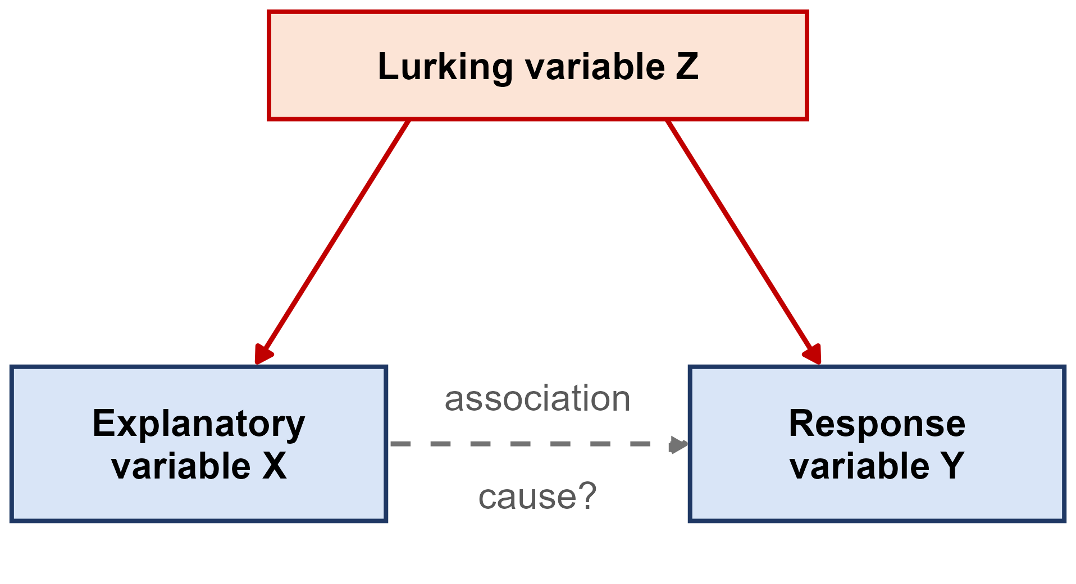
Association is not causation
association
two variables move together in the data
causation
changing one variable would change the other
lurking variable
a variable not in the study that influences both the explanatory and the response variable
confounded
two variables whose effects on the response cannot be separated
Ice cream sales and drownings rise together. The lurking variable: hot weather. The association is real - the causal story is not.

Slide 34
Hormone therapy and heart disease
Large observational studies, such as the Nurses' Health Study, found that women who took hormone therapy after menopause had less heart disease
The Women's Health Initiative then randomly assigned 16,608 women aged 50 to 79 to estrogen plus progestin or a placebo
It was stopped early in 2002 because the risks outweighed the benefits: more breast cancer, and MORE heart disease, not less
Why did the observational studies point the wrong way?
Lurking variables.
Women who chose hormone therapy tended to be wealthier, better educated and healthier to start with - and that,
not the hormones, lowered their heart risk. Random assignment balanced those differences out.
Source: Writing Group for the WHI Investigators (2002), JAMA

Slide 35
Can we claim cause without an experiment?
Nobody can randomly assign people to smoke for thirty years - or randomly assign their birth order
Yet we are confident that smoking causes lung cancer. Decades of observational studies found:
  a strong association, found again and again in different populations
  a dose-response pattern: the more cigarettes, the higher the risk
  the right order in time: the smoking comes before the cancer
  a plausible biological explanation, backed by laboratory evidence
The 2014 Surgeon General's report: smoking causes at least 480,000 premature U.S. deaths a year, about 127,700 of them from lung cancer
Without an experiment, a causal claim needs this much evidence - never one study
Source: U.S. Department of Health and Human Services (2014)

Slide 36
The language of experiments
experimental units
the individuals or objects the treatments are applied to
subjects
experimental units that are people
factor
an explanatory variable the researcher controls
levels
the specific values a factor is set to
treatment
the condition a unit receives: one combination of factor levels

Slide 37
Example: the VITAL trial
VITAL randomly assigned 25,871 U.S. adults to vitamin D (2,000 IU a day) or a placebo, AND to omega-3 fish oil (1 g a day) or a placebo, then followed them for about 5 years.
1. What are the experimental units - and what do we call them?
The 25,871 adults. They are people, so they are subjects.
2. What are the factors, and how many levels does each have?
Vitamin D and omega-3 - 2 levels each (the supplement or a placebo).
3. How many treatments are there?
2 x 2 = 4: vitamin D + omega-3, vitamin D + placebo, placebo + omega-3, placebo + placebo.
4. What happened?
Neither supplement lowered the rate of invasive cancer or of major cardiovascular events.
Source: Manson et al. (2019), New England Journal of Medicine

Slide 38
Principles of experimental design
control
compare the treatment against a control group, so the treatment is the only systematic difference between the groups
random assignment
let chance assign units to treatments - it balances the lurking variables we know about AND the ones we do not
replication
put enough units in each group that chance differences between the groups average out

Slide 39
Placebos and blinding
placebo
an inactive treatment that looks exactly like the real one
a sugar pill, or a saline injection
placebo effect
people often improve simply because they believe they are being treated
in one study, believing you had taken a performance drug worked almost as well as the drug itself
blinding
the subjects do not know which treatment they received
double-blind
neither the subjects nor the researchers working with them know who received what

Slide 40
The 2020 Pfizer-BioNTech vaccine trial
43,548 people were randomly assigned, half and half, to two shots of the COVID-19 vaccine or two shots of a saline placebo. Participants and the staff assessing them did not know who got which. Afterwards: 8 COVID-19 cases in the vaccine group, 162 in the placebo group.
1. Why give the control group a saline shot instead of no shot at all?
So both groups have the same experience. A difference in cases can then only come from the vaccine, not from expectations.
2. Why randomize, instead of letting people choose whether to get the vaccine?
People who choose a new vaccine may also be more careful in other ways - a lurking variable. Randomizing balances it.
3. What does 8 cases versus 162 suggest?
The vaccine group had about 95% fewer cases - and because of the design, we can credit that to the vaccine.
Source: Polack et al. (2020), New England Journal of Medicine

Slide 41
A placebo surgery
Arthroscopic knee surgery for arthritis was common, and patients said it helped
Moseley and colleagues (2002) randomly assigned 180 patients with knee osteoarthritis to two real arthroscopic procedures, or to placebo surgery - skin incisions only, with no instruments inserted
Patients, and the staff who assessed their pain, did not know who got which
Over two years, which group reported the most improvement?
None of them.
The placebo group did as well as both surgery groups on pain and function. The benefit came from believing
you had surgery - and without a placebo group and blinding, nobody would have known.
Source: Moseley et al. (2002), New England Journal of Medicine

Slide 42
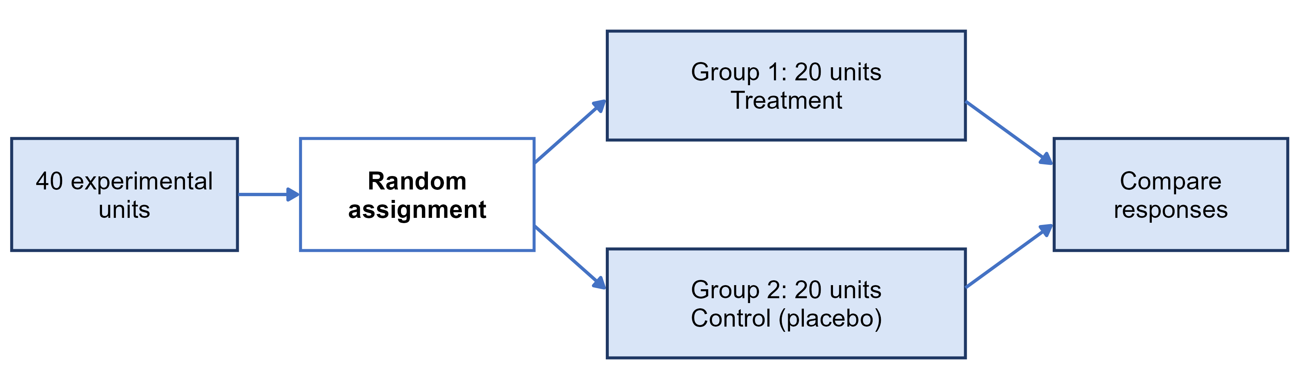
Completely randomized design
completely randomized design
every unit is assigned to a treatment completely at random - the simplest design
The Pfizer-BioNTech vaccine trial was a completely randomized design with two groups

Slide 43
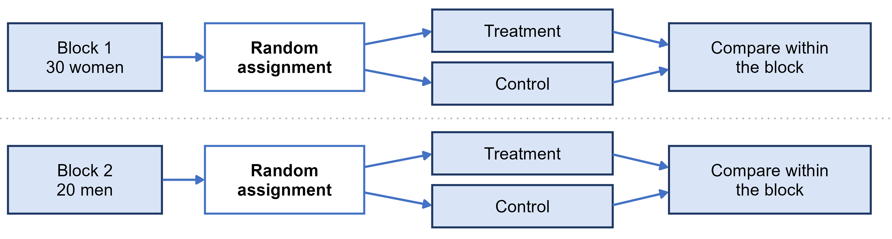
Randomized block design
block
a group of units that are alike in a way that affects the response, formed BEFORE treatments are assigned
randomized block design
randomize treatments separately inside each block, then compare treatments within blocks
blocking is to experiments what stratifying is to sampling

Slide 44
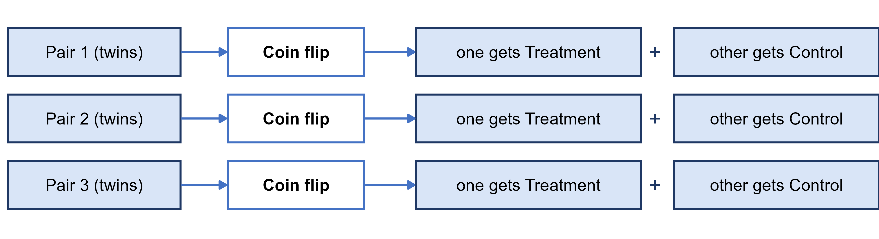
Matched pairs design
matched pairs design
a block design where every block is a pair of very similar units, and a coin flip decides which one gets each treatment
or each subject is their own pair, receiving both treatments in a random order
Before-and-after data with no random order or control group is much weaker evidence

Slide 45
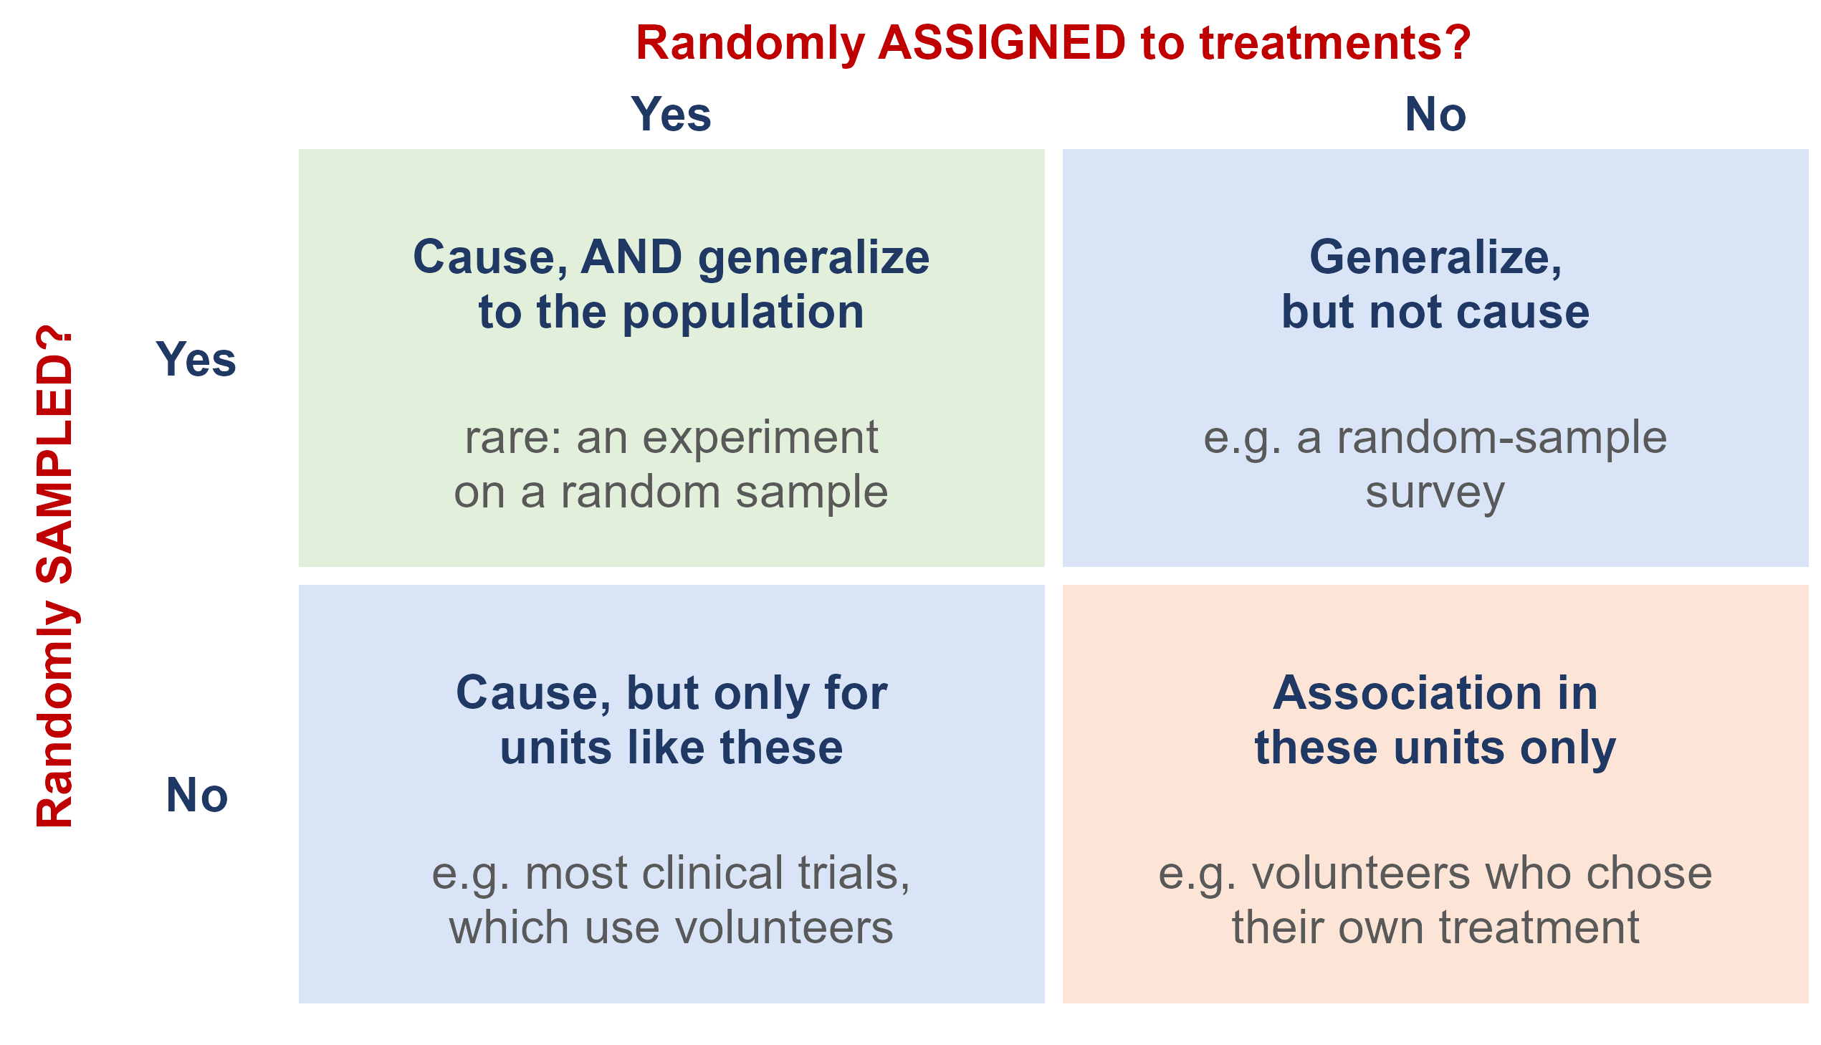
What does randomization buy you?
Random sampling lets you generalize from the sample to the population
Random assignment lets you conclude cause and effect
Most studies have only one. A trial on volunteers shows a vaccine works - for people like those volunteers

Slide 46
Practice: design the study
You want to know whether texting slows how quickly a driver reacts when the car ahead brakes.
1. What are the explanatory variable, the response variable, and the treatments?
Explanatory: texting or not. Response: reaction time. Treatments: driving while texting, and driving only.
2. Your partner wants to split drivers at random into a texting group and a driving-only group. Is there a better design?
Matched pairs: each driver does both, in a random order. Reaction times vary a lot between people, so compare each driver to themselves.
3. Can the study be blinded?
Not for the drivers - they know when they are texting. But the person measuring reaction times can be kept blind.
Adapted from Introductory Statistics 2e (OpenStax), Section 1.4, Try It 1.21

Slide 47
Ethics: the Facebook experiment
For one week in January 2012, Facebook changed the News Feeds of 689,003 users: some saw fewer positive posts, some fewer negative ones. The results were published in 2014. The users never knew.
1. Facebook said agreeing to its Data Use Policy counted as informed consent. Do you agree?
The journal did not: its Expression of Concern said the study may not have met the principles of informed consent and the chance to opt out.
2. Why did no ethics board stop it?
Facebook, a private company, was not bound by the federal rules. Cornell's board decided its researcher was not directly involved, so it did no review.
3. What is the lesson?
Clicking I agree on a terms-of-service page is not informed consent - even for a well-designed experiment.
Sources: Kramer, Guillory and Hancock (2014), PNAS; PNAS Editorial Expression of Concern (2014)

Slide 48
The Belmont Report: three principles
Why the rules exist: in the U.S. Public Health Service syphilis study at Tuskegee (1932 to 1972), hundreds of Black men with syphilis were left untreated without informed consent. The Belmont Report (1979) followed.
respect for persons
people decide for themselves whether to take part
beneficence
do no harm: maximize the possible benefits and minimize the possible risks
justice
the burdens and benefits of research are shared fairly

Slide 49
Research ethics today
informed consent
subjects are told the purpose, procedures and risks in advance, and can refuse or quit at any time
confidentiality
information about individuals is protected and never released in a form that identifies them
Institutional Review Board (IRB)
reviews and approves studies on human subjects before they start
at UI, through the Office of Research Assurances

Slide 50
Ethics: honest data
Ethics also means honest data. An investigation of psychologist Diederik Stapel found he had invented data: it tainted more than 55 of his papers and 10 PhD dissertations he supervised. A researcher is surveying households in a community:
1. They choose a block where they already know many of the neighbors. What is the problem?
A convenience sample - it is biased, and claiming it represents the community is misleading.
2. Nobody is home at four houses, so they skip them and never go back. What is the problem?
Nonresponse - people who are not home, such as working families, may differ from the people who are.
3. Running late, they fill in four forms with answers copied from neighbors. What is the problem?
Fabricated data. It is never acceptable, even when the answers look realistic.
Source: Introductory Statistics 2e (OpenStax), Section 1.4 and Example 1.22

Slide 51
Practice: what design, and can it show cause?
1. A survey finds that people who own dogs have lower blood pressure than people who do not.
Observational - nobody was assigned a dog. Active people may both own dogs and have lower blood pressure.
2. 60 volunteers with insomnia are randomly split: 30 get melatonin, 30 get an identical-looking placebo.
Completely randomized experiment - it can show cause, for people like these volunteers.
3. In each of 4 greenhouses, tomato plants are randomly assigned to fertilizer A or fertilizer B.
Randomized block design, with greenhouses as the blocks - it can show cause.
4. Subjects complete mazes wearing a floral-scented mask and an unscented mask, in a random order. Can the subjects be blinded?
No - they can smell the flowers. But the researchers timing the mazes can be blinded. (Textbook Example 1.20)

